Slide 1

Semantic Kernel Hackathon

Slide 2


Welcome
Hackathons are a great platform for innovation, skill development, relationship building, and problem solving. Semantic Kernel runs hackathons across the world and have seen incredibly impressive results.
+
=
Semantic Kernel
You
Innovation

Slide 3

Let’s talk about AI
Check out the resources here to learn about the latest on AI at Microsoft.
You dream it. AI helps build it. Microsoft is empowering the world to achieve more with AI and its copilot ecosystem.

Slide 4
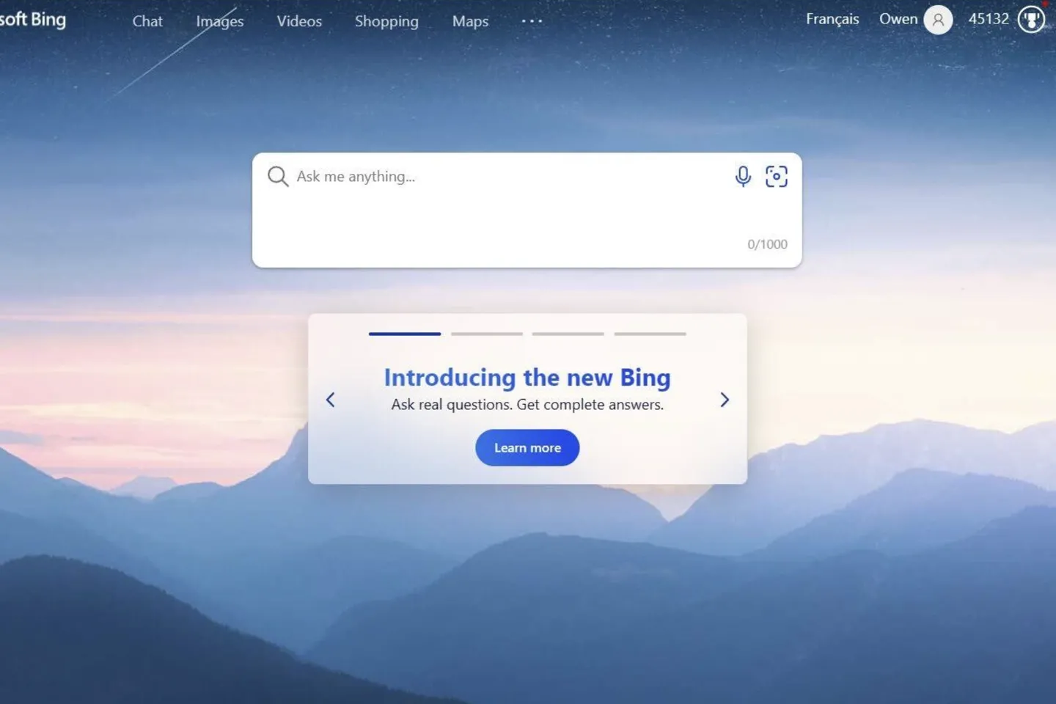
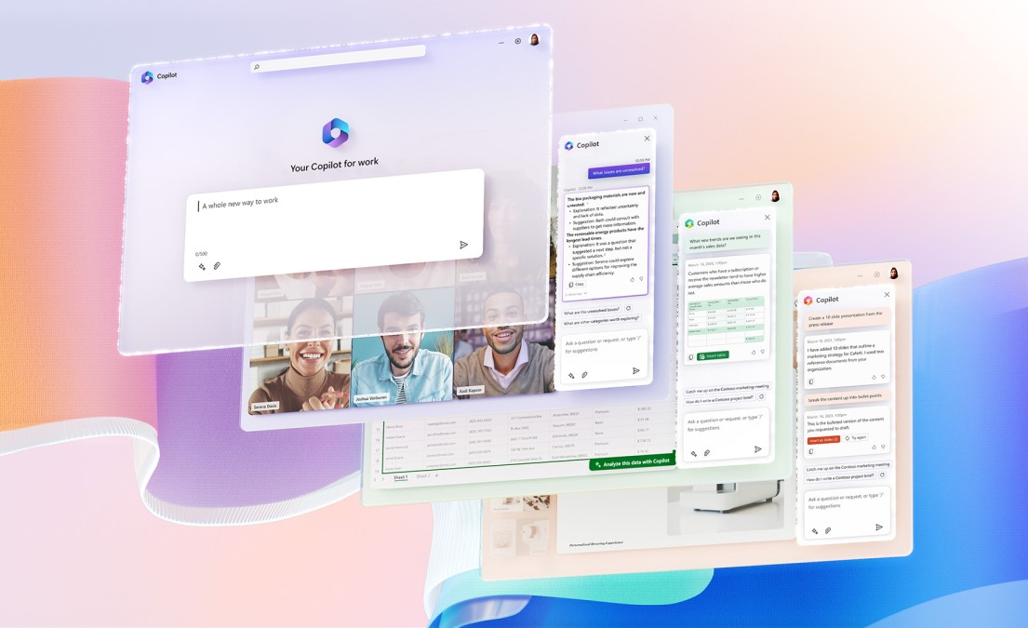
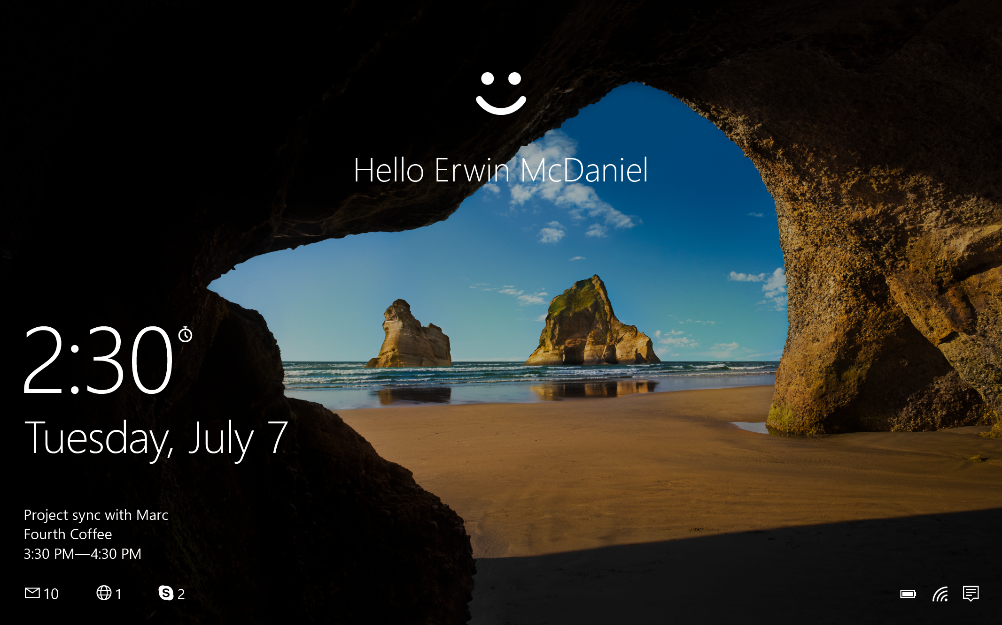
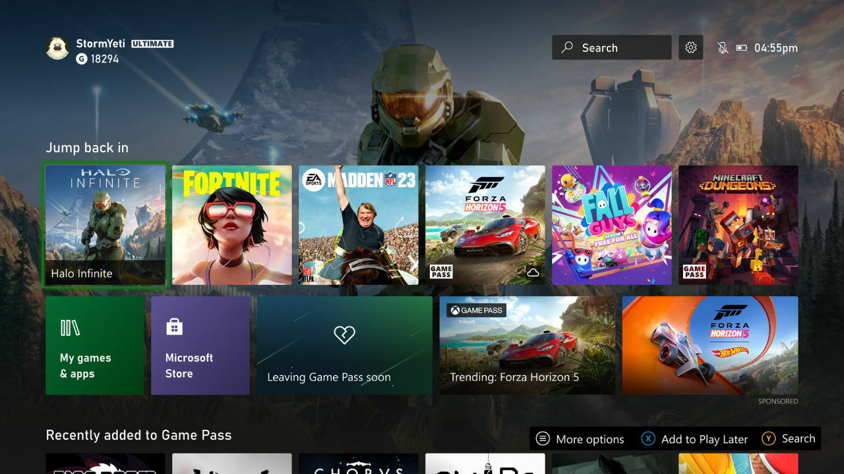
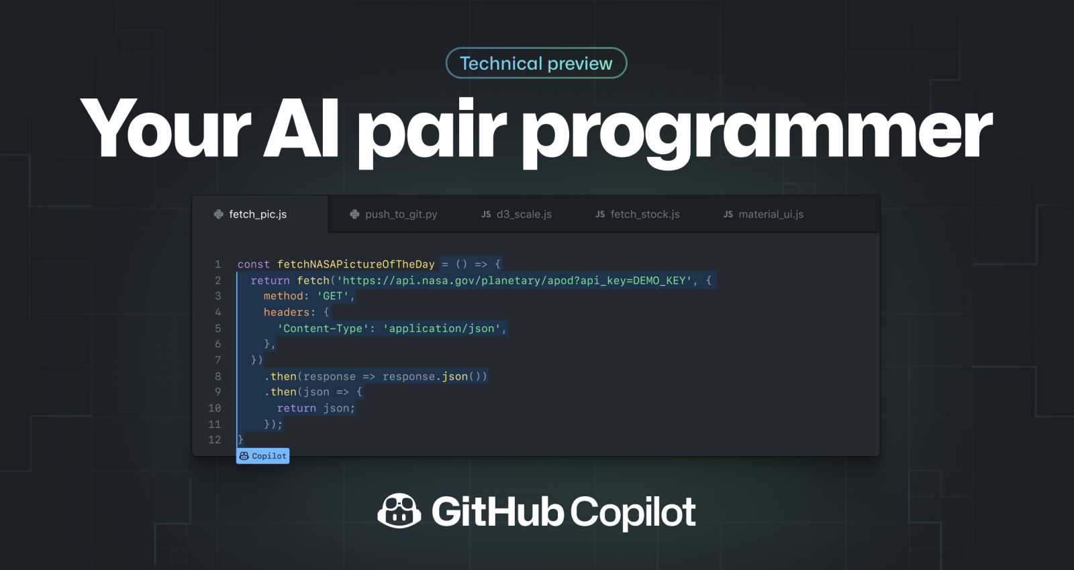





Modernized & augmented flagship products with copilot
AI-based search with Microsoft Copilot
Copilot for Work across Office 365
Biometric identity verification
Personalized recommendations
Copilot assisted coding

Slide 5


Apps
Plugin extensibility
At the center of it all is Semantic Kernel
Copilots
AI orchestration
Foundation models
AI infrastructure
S E M A N T I C K E R N E L / Microsoft confidential

Slide 6



What is Semantic Kernel?
An open-source SDK that lets you easily build agents that call your existing code. As a highly extensible framework, it can be used with models from OpenAI, Azure OpenAI, Hugging Face, and more!
By combining your existing C#, Python, and Java code with these models, you can build agents that answer questions and automate processes.
Python
Java
.Net

Slide 7

A bridge between LLMs and your code
Your models
Your code
ML RESEARCHER
APP DEVELOPER
keeping up with advances
stable and performant
cutting edge models
efficient to deliver
algorithm analysis
easily scalable
experimentation
maintainable
Your memories
Your prompts

Slide 8
Plugins &
These are the core building blocks of Semantic Kernel. By customizing these key components, you can create solutions to suite exactly your needs.
Planners &
Personas

Slide 9









Plugins
Plugins encapsulate capabilities into a single unit of functionality. When you build a plugin for Semantic Kernel, you can leverage it on other services, like ChatGTP, Bing, and Microsoft 365. Likewise, any plugin built for those services can seamlessly import to Semantic Kernel.
Plugins
Other AI apps
Semantic Kernel
Your app

Slide 10







Semantic or native?
To make a plugin, you'll need to create some functions. These are either semantic or native – you decide.
Time plugin
Semantic functions
Semantic functions
Endpoint
Semantic Kernel

Slide 11



Planners
Person has a request
A Planner is a function that takes the initial request and returns a list of steps needed to fulfill the request. AI is used to mix-and-match plugins registered in the kernel so it can recombine them into a series of steps.
Semantic Kernel
Plugins
Plan

Slide 12


Handlebars or stepwise?
To make plans, you'll need to define which planner to use. Choose between handlebars or stepwise planner.
Planner
Handlebars
Stepwise

Slide 13




Personas
Project manager agent
Personas are what defines an agent's role, like a set of instructions. They hold their own memories which provide broader context to the requests made.
This is what empowers multi-agent systems where specialists are defined to execute requests they were designed to fulfil.
Researcher agent
Copywriter agent
Designer agent

Slide 14
Managing personas
Agent orchestrator plugin
Through plugins, planners orchestrate agents. Choosing the best agent for the request.
Project manager agent
Researcher agent
Copywriter agent
Designer agent

Slide 15
Memories
This is what provides context to the initial request. Memories are fed into Semantic Kernel in a few different ways.
Conventional key-value pairs: Just like you would set an environment variable in your shell, the same can be done when using Semantic Kernel. The lookup is "conventional" because it's a one-to-one match between a key and your query.
Conventional local-storage: When you save information to a file, it can be retrieved with its filename. When you have a lot of information to store in a key-value pair, you're best off keeping it on disk.
Semantic memory search: You can also represent text information as a long vector of numbers, known as "embeddings." This lets you execute a "semantic" search that compares meaning-to-meaning with your query.

Slide 16
Prompts
This is how you communicate with model. It serves as the input which elicits a response from the model. Selecting the right words, phrases, symbols, and formats that guide the model in generating high-quality and relevant results.

Slide 17
Responsible AI principles
Fairness – AI systems treat all people fairly.
Reliability & safety – AI systems should perform reliably and safely.
Privacy & security – AI systems should be secure and respect privacy.
Inclusiveness – AI systems should empower everyone and engage people.
Transparency – AI systems should be understandable.
Accountable – People should be accountable for AI systems.

Slide 18
Tutorials
Want some extra guidance? Check out these detailed walk throughs here

Slide 19
Questions?
Raise your hand.

Slide 20



Want to learn more?
Browse the Github repo & community board
Join the Discord community
Follow the dev blogs
https://aka.ms/sk/discord
https://aka.ms/sk/blog
https://aka.ms/sk/repo

